Slide 1

Group 6
Anvitha Ananth
Yogesh Gawande
Pradeep Kumaraswamy
Alagappan Sathappan
Shubhodeep Sengupta
S

Slide 2

Agenda
Executive Summary
Business Objective
Segmentation Overview
Segment Analysis & Recommendations
Financial Implications

Slide 3
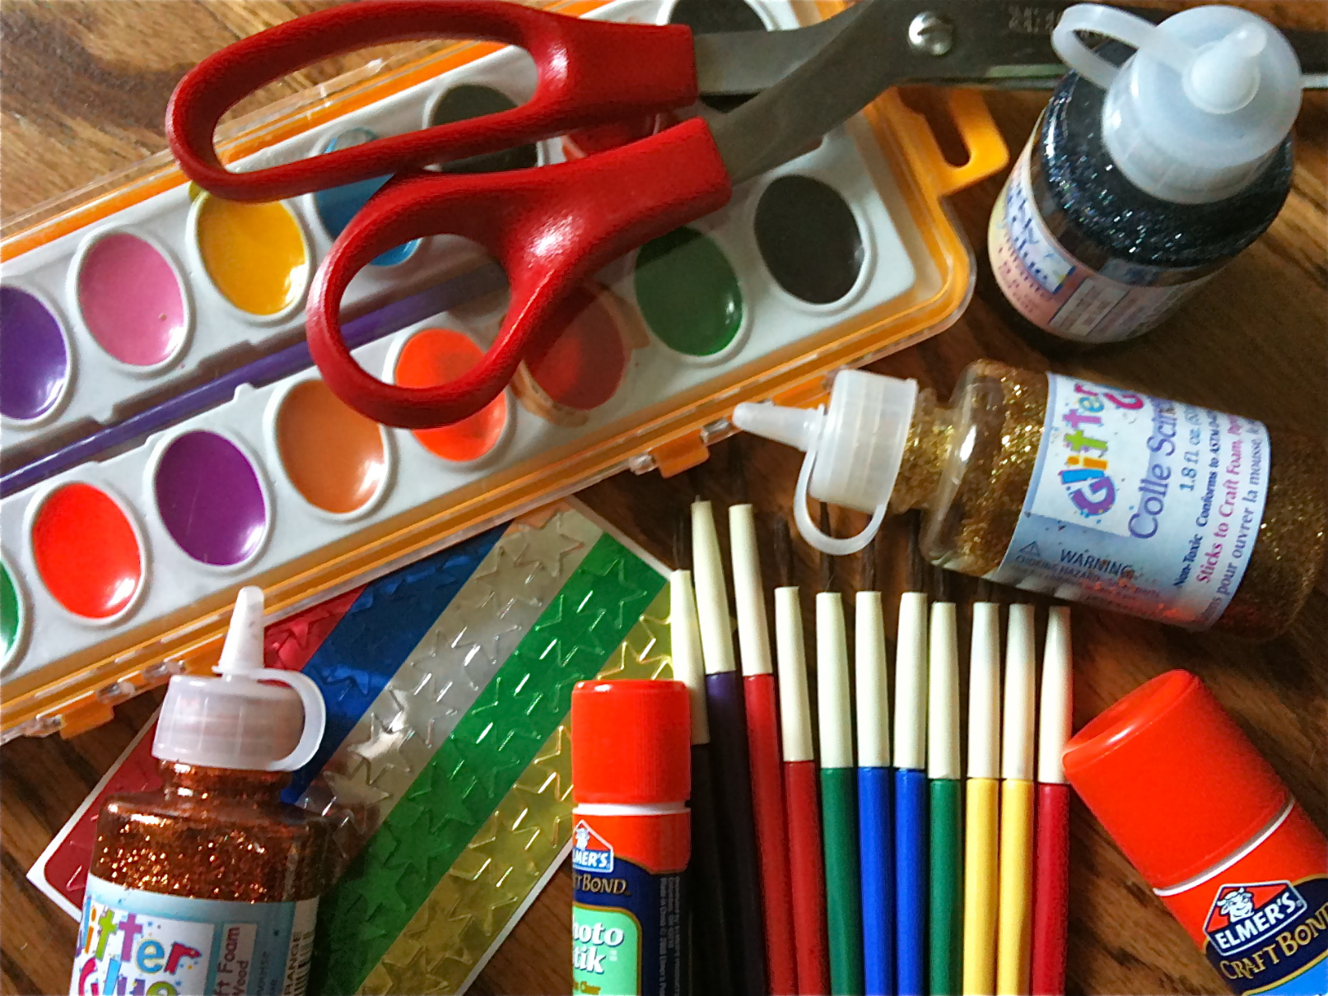
Executive Summary
Founded in 1943
Leading fabric and craft retailer
865 stores in 49 states
$2.4 Billion in revenue in 2017
Business Objective
To maximize revenue based on
Pricing
Product Bundling
Marcom Channel Mix
Financial Implications
$ 96,732.74 increase in revenue – 13.58 % improvement

Slide 4

Analysis Strategy
Segmentation
Marcom
Cluster Analysis
Customer share
Product Quantity share
Revenue share
Product Purchase Patterns
Price Sensitivity Analysis
Adjust prices
Identify Elasticity
Market Basket Analysis
High Purchase Probability Bundles
Low Purchase Probability Bundles
Marcom Channel Mix
Effect of Marcom
Ordinary Regression Analysis

Slide 5

Segmentation Overview
Segment 1: Thrifty Shoppers
Segment 2: High Rollers
Segment 3: Fleece Lovers
Segment 4: Paper is Life !
Segment 5: Let's Sew Them

Slide 6
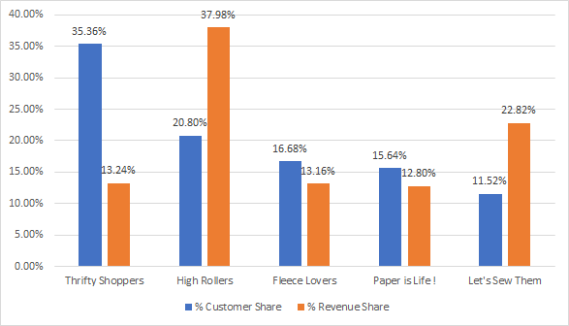
Segment Characteristics

Slide 7
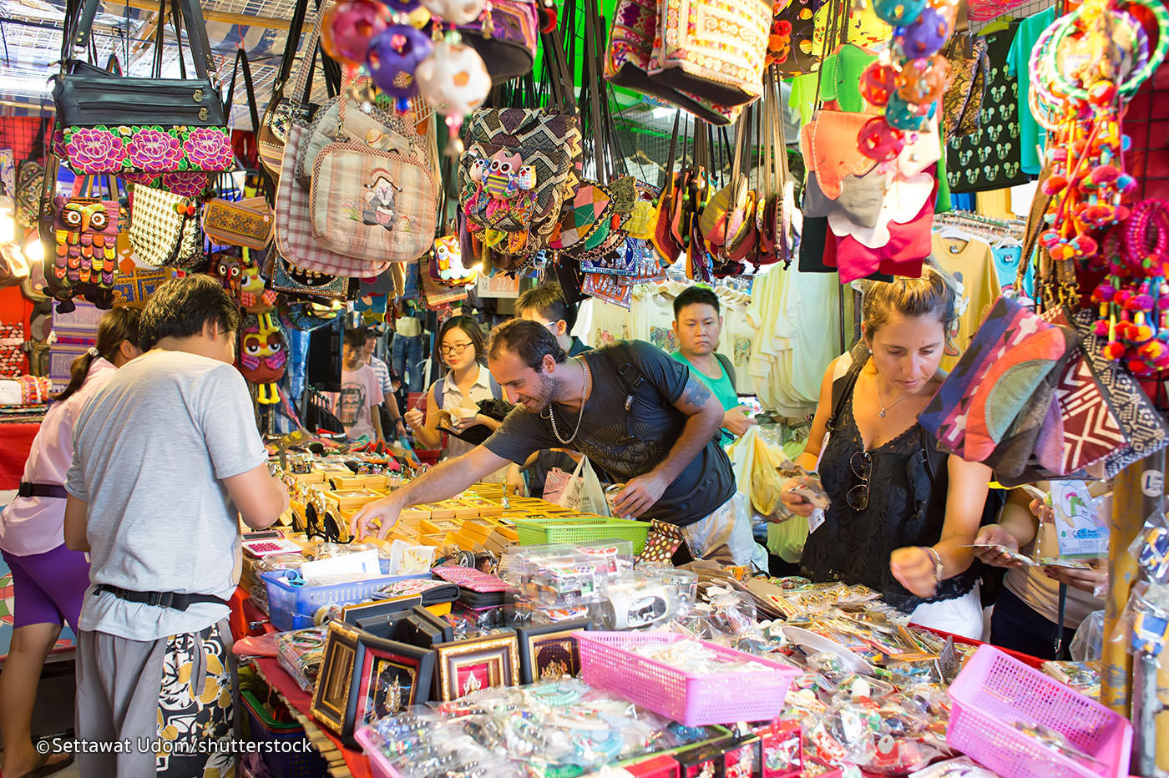
Segment 1: Thrifty Shoppers
Key Characteristics:
Largest Customer Share (35.36%)
65% Lower Revenue Share Compared to The Largest.
Top Products By Revenue
Other, Sew, Needle

Slide 8

Segment 1 : Thrifty Shopper
Recommendations:
PRICING
20 % Price Increase (except Product Warm)
5% Discount for Product Warm
BUNDLING
Attractive Product Bundles
Special and Homedec. – 891% Increase in Purchase Prob
Seasfloral and Impulse – 625% Increase in Purchase Prob
Avoid Product Bundles
Other and Special – 100 % Decrease in Purchase Prob
MARCOM
Reduce Mail by 10%
Reduce Email by 15%
Continue Focus on SMS

Slide 9

Segment 1: Thrifty Shoppers
Financial Implications
PRICING
11.74 % Revenue Increase
Incremental Revenue Change: $ 11,074.64
Top Product Revenue Gains:
MARCOM
12.56 % Marcom Cost Savings
Product | % Rev Change
Sew | 18.22%
Foam | 15.96%
Other | 14.69%

Slide 10

Segment 2: High Rollers
Key Characteristics:
Largest Revenue Share (37.98%)
2nd Largest Customer Share (20.63%)
Top Products by Revenue
Other, Sew, Quilt

Slide 11

Segment 2: High Rollers
Recommendations:
PRICING
20 % Price Increase
BUNDLING
Attractive Product Bundles
Paint and Other – 203% Increase in Purchase Prob
Paper and Sew – 123 % Increase in Purchase Prob
Avoid Product Bundles
Needle and Warm – 82% Decrease in Purchase Prob
MARCOM
Reduce Email by 20%
Continue Focus on Mail

Slide 12
Segment 2: High Rollers
Financial Implications
PRICING
14.23 % Revenue Increase
Incremental Revenue Change: $ 38,510.14
Top Product Revenue Gains:
MARCOM
7.92 % Marcom Cost Savings
Product | % Rev Change
Sew | 19.91%
Needle | 19.47%
Other | 19.03%

Slide 13
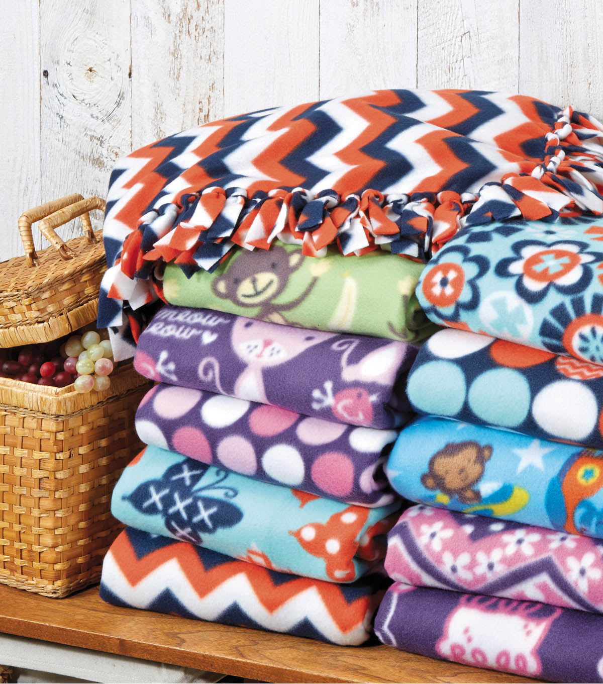
Segment 3: Fleece Lovers
Key Characteristics:
3rd Largest Customer Share (16.68%)
4th Largest Revenue Share (13.16%)
Highest SMS received (avg.)
Top Products by Revenue
Fleece, Other, Sew

Slide 14
Segment 3: Fleece Lovers
Recommendations:
PRICING
20 % Price Increase
BUNDLING
Attractive Product Bundles
Needle and Foam – 372% Increase in Purchase Prob
Needle and Ribbon – 330% Increase in Purchase Prob
Avoid Product Bundles
Fleece and Special – 99% Decrease in Purchase Prob
MARCOM
Reduce Mail by 10%
Reduce Email by 10%
Continue Focus on SMS

Slide 15
Segment 3: Fleece Lovers
Financial Implications:
PRICING
12.87 % Revenue Increase
Incremental Revenue Change: $ 12,072.34
Top Product Revenue Gains:
MARCOM
9.85 % Marcom Cost Savings
Product | % Rev Change
Other | 17.90%
Sew | 17.68%
Seasfloral | 17.65%

Slide 16

Segment 4: Paper is Life!
Key Characteristics:
Smallest Revenue Share (12.80%)
2nd Smallest Customer Share (15.64%)
Top Products by Revenue
Paper, Other, Sew

Slide 17
Segment 4: Paper is Life!
Recommendations:
PRICING
20 % Price Increase
BUNDLING
Attractive Product Bundles
Warm and Quilt - 961% Increase in Purchase Prob
Special and Fabric - 679% Increase in Purchase Prob
Avoid Product Bundles
Paper and Jewelry – 99% Decrease in Purchase Prob
MARCOM
Reduce Mail by 10%
Reduce Email by 10%
Continue Focus on SMS

Slide 18
Segment 4: Paper is Life!
Financial Implications:
PRICING
13.14% revenue Increase
Incremental Revenue Change: $ 11,984.02
Top Product Revenue Gains:
MARCOM
9.91 % Marcom Cost Savings
Product | % Rev Change
Paper | 19.69%
Sew | 18.04%
Other | 17.05%

Slide 19
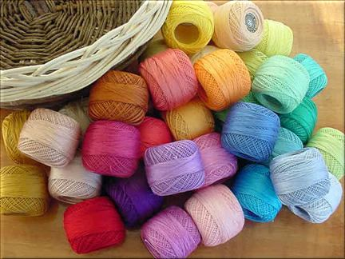
Segment 5: Let's sew them
Key Characteristics:
Smallest Customer Share (11.52%)
2nd Largest Revenue Share (22.82%)
Top Products by Revenue
Sew, Other, Paper

Slide 20
Segment 5: Let's sew them
Recommendations:
PRICING
20 % Price Increase(except special)
20 % Discount on Product Special
BUNDLING
Attractive Product Bundles
Public and Impulse – 193% in Purchase Prob
Fabric and Quilt – 168% in Purchase Prob
Avoid Product Bundles
Paper and Special – 70% Decrease in Purchase Prob
MARCOM
Reduce Email by 20%
Continue Focus on Mail and SMS

Slide 21
Segment 5: Let's sew them
Financial Implications:
PRICING
14.2% Revenue Increase
Incremental Revenue Change: $ 23,091.60
Top Product Revenue Gains:
MARCOM
8.59% Marcom Cost Savings
Product | % Rev Change
Sew | 19.78%
Other | 19.16%
Pct | 18.71%

Slide 22
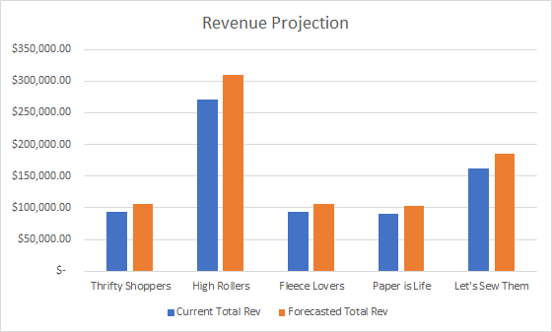
Financial Implications - Consolidated

Slide 23
Financial Implications - Consolidated
Cluster | Current Total Rev | Projected Incremental Rev | Forecasted Total Rev | % Rev Change
Thrifty Shoppers | $ 94,357.54 | $ 11,074.64 | $ 105,432.18 | 11.74%
High Rollers | $ 270,604.19 | $ 38,510.14 | $ 309,114.33 | 14.23%
Fleece Lovers | $ 93,807.19 | $ 12,072.34 | $ 105,879.53 | 12.87%
Paper is Life | $ 91,216.24 | $ 11,984.02 | $ 103,200.26 | 13.14%
Let's Sew Them | $ 162,578.40 | $ 23,091.60 | $ 185,670.00 | 14.20%
Total | $ 712,563.56 | $ 96,732.74 | $ 809,296.30 | 13.58%

Slide 24
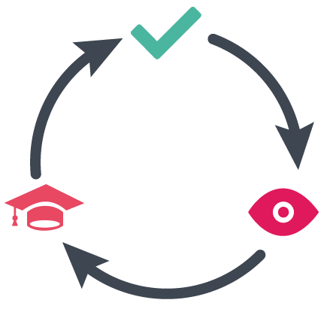
Test and Learn Plan
Monitor marcom performance on sales
Improved: Continue with reduction in frequency
Decline: Issue could be with content quality and not frequency
Increase discounts if current discount levels don’t work
Product Jewelry has an almost elastic demand for segment 1 & 3
Might have to decrease the price soon

Slide 25

THANK YOU

